Slide 1
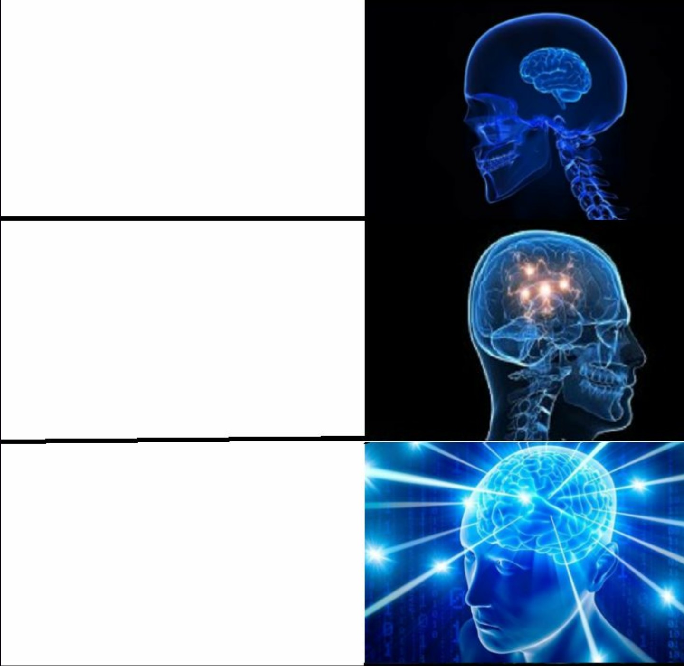

Rich Errors
throw UserNotFoundException()
sealed interface UserResult {
data object UserNotFound
data class Success(val user: User)
}
2.4: Checked Exceptions
error class UserNotFound
fun getUser(): User | UserNotFound

Slide 2
Rich Errors in a nutshell

Slide 3
Rich Errors in a nutshell
suspend fun getUser(id: UserId): User {
...
}

Slide 4
Rich Errors in a nutshell
/**
* @throws UserNotFoundException if user not found (wow)
* @throws IOException if transport issues occur
*/
suspend fun getUser(id: UserId): User {
...
}

Slide 5

Rich Errors in a nutshell
/**
* @throws UserNotFoundException if user not found (wow)
* @throws IOException if transport issues occur
*/
suspend fun getUser(id: UserId): User {
...
}

Slide 6

Rich Errors in a nutshell

Slide 7
Rich Errors in a nutshell
sealed interface GetUserResult {
data object UserNotFound : GetUserResult
data class TransportError(val exception: IOException) : GetUserResult
data class Success(val user: User) : GetUserResult
}
suspend fun getUser(id: UserId): GetUserResult {
...
}

Slide 8
Rich Errors in a nutshell
suspend fun getUser(userId: UserId): GetUserResult
suspend fun main() {
val userId: UserId = TODO()
when (val result = getUser(userId)) {
is UserNotFound -> println("User not found")
is TransportError -> println("Can't fetch user")
is Success -> println("User: ${result.user}")
}
}

Slide 9
Rich Errors in a nutshell
suspend fun getUser(userId: UserId): GetUserResult
suspend fun User.getChat(chatId: ChatId): GetChatResult

Slide 10
Rich Errors in a nutshell
suspend fun getUser(userId: UserId): GetUserResult
suspend fun User.getChat(chatId: ChatId): GetChatResult
suspend fun main() {
val userId: UserId = TODO()
val chatId: ChatId = TODO()
val userResult = getUser(userId)
if (userResult is GetUserResult.Success) {
val chatResult = userResult.user.getChat(chatId)
if (chatResult is GetChatResult.Success) {
println("Chat: ${chatResult.chat}")
}
}
}

Slide 11
Rich Errors in a nutshell
suspend fun getUserOrNull(userId: UserId): User?
suspend fun User.getChatOrNull(chatId: ChatId): Chat?

Slide 12
Rich Errors in a nutshell
suspend fun getUserOrNull(userId: UserId): User?
suspend fun User.getChatOrNull(chatId: ChatId): Chat?
suspend fun main() {
val userId: UserId = TODO()
val chatId: ChatId = TODO()
val chat = getUserOrNull(userId)?.getChatOrNull(chatId)
if (chat != null) {
println("Chat: $chat")
}
}

Slide 13
Rich Errors in a nutshell
suspend fun getUserOrNull(userId: UserId): User?
suspend fun User.getChatOrNull(chatId: ChatId): Chat?
suspend fun main() {
val userId: UserId = TODO()
val chatId: ChatId = TODO()
val chat = getUserOrNull(userId)?.getChatOrNull(chatId)
if (chat != null) {
println("Chat: $chat")
} else {
// What’s the reason?
}
}

Slide 14
Rich Errors in a nutshell
Conciseness vs Informativeness

Slide 15
Rich Errors in a nutshell
Conciseness vs Informativeness
suspend fun getUser(userId: UserId): GetUserResult
suspend fun User.getChat(chatId: ChatId): GetChatResult
suspend fun getUserOrNull(userId: UserId): User?
suspend fun User.getChatOrNull(chatId: ChatId): Chat?

Slide 16

Rich Errors in a nutshell
Conciseness vs Informativeness

Slide 17
Rich Errors in a nutshell

Slide 18
Rich Errors in a nutshell
error object UserNotFound

Slide 19
Rich Errors in a nutshell
error class TransportError(val exception: IOException)
error object UserNotFound

Slide 20
Rich Errors in a nutshell
final error class TransportError(val exception: IOException) // No Generics!
final error object UserNotFound

Slide 21
Rich Errors in a nutshell
error class TransportError(val exception: IOException)
error object UserNotFound

Slide 22
Rich Errors in a nutshell
error class TransportError(val exception: IOException)
error object UserNotFound
suspend fun getUser(userId: UserId): User | UserNotFound | TransportError

Slide 23
Rich Errors in a nutshell
error class TransportError(val exception: IOException)
error object UserNotFound
typealias GetUserError = UserNotFound | TransportError
suspend fun getUser(userId: UserId): User | GetUserError

Slide 24
Rich Errors in a nutshell
error class TransportError(val exception: IOException)
error object UserNotFound
typealias GetUserError = UserNotFound | TransportError
suspend fun getUser(userId: UserId): User | GetUserError
error object ChatNotFound
typealias GetChatError = ChatNotFound | TransportError
suspend fun User.getChat(chatId: ChatId): Chat | GetChatError

Slide 25
Rich Errors in a nutshell
suspend fun getUser(userId: UserId): User | GetUserError
suspend fun User.getChat(chatId: ChatId): Chat | GetChatError
suspend fun main() {
}

Slide 26
Rich Errors in a nutshell
suspend fun getUser(userId: UserId): User | GetUserError
suspend fun User.getChat(chatId: ChatId): Chat | GetChatError
suspend fun main() {
val userId: UserId = TODO()
val chatId: ChatId = TODO()
val chat = getUser(userId)?.getChat(chatId)
if (chat is Chat) {
println("Chat: $chat")
}
}

Slide 27
Rich Errors in a nutshell
✅ Conciseness
suspend fun getUser(userId: UserId): User | GetUserError
suspend fun User.getChat(chatId: ChatId): Chat | GetChatError
suspend fun main() {
val userId: UserId = TODO()
val chatId: ChatId = TODO()
val chat = getUser(userId)?.getChat(chatId)
if (chat is Chat) {
println("Chat: $chat")
}
}

Slide 28
Rich Errors in a nutshell
✅ Conciseness
suspend fun getUser(userId: UserId): User | GetUserError
suspend fun User.getChat(chatId: ChatId): Chat | GetChatError
suspend fun main() {
val userId: UserId = TODO()
val chatId: ChatId = TODO()
val chat = getUser(userId)?.getChat(chatId)
if (chat is Chat) {
println("Chat: $chat")
} else {
// chat: TransportError | UserNotFound | ChatNotFound
}
}

Slide 29
Rich Errors in a nutshell
✅ Conciseness
✅ Informativeness
suspend fun getUser(userId: UserId): User | GetUserError
suspend fun User.getChat(chatId: ChatId): Chat | GetChatError
suspend fun main() {
val userId: UserId = TODO()
val chatId: ChatId = TODO()
val chat = getUser(userId)?.getChat(chatId)
if (chat is Chat) {
println("Chat: $chat")
} else {
// chat: TransportError | UserNotFound | ChatNotFound
}
}

Slide 30
Rich Errors in a nutshell
✅ Conciseness
✅ Informativeness
suspend fun getUser(userId: UserId): User | GetUserError
suspend fun User.getChat(chatId: ChatId): Chat | GetChatError
suspend fun main() {
val userId: UserId = TODO()
val chatId: ChatId = TODO()
val chat = getUser(userId)?.getChat(chatId)
when (chat) {
is UserNotFound -> println("User not found")
is ChatNotFound -> println("Chat not found")
is TransportError -> println("IO Problems ${chat.exception}")
is Chat -> println("Chat: $chat")
}
}

Slide 31
Rich Errors in a nutshell
✅ Conciseness
✅ Informativeness
suspend fun getUser(userId: UserId): User | GetUserError
suspend fun User.getChat(chatId: ChatId): Chat | GetChatError
suspend fun main() {
val userId: UserId = TODO()
val chatId: ChatId = TODO()
val chat = getUser(userId)?.getChat(chatId)!!
println("Chat: $chat")
}

Slide 32
Rich Errors in a nutshell
✅ Conciseness
✅ Informativeness
suspend fun getUser(userId: UserId): User | GetUserError
suspend fun User.getChat(chatId: ChatId): Chat | GetChatError
suspend fun main() {
val userId: UserId = TODO()
val chatId: ChatId = TODO()
val chat = getUser(userId)?.getChat(chatId)!! // throw KotlinError(ChatNotFound)
println("Chat: $chat")
}

Slide 33
Rich Errors in a nutshell
error object ChatNotFound {
operator fun throw(): Nothing {
throw IllegalStateException("Nooooo, how could you...")
}
}

Slide 34
Rich Errors in a nutshell
error object ChatNotFound {
operator fun throw(): Nothing {
throw IllegalStateException("Nooooo, how could you...")
}
}
val chat = getUser(userId)?.getChat(chatId)!! // throw IllegalStateException(...)

Slide 35
No elvis operator :( ?:
val chat = getUser(userId)?.getChat(chatId) ?: return null

Slide 36
No elvis operator :( ?:
val chat = getUser(userId)?.getChat(chatId) ?: println(chat)

Slide 37

Finally, Union Types

Slide 38
Union Types? Not quite...

Slide 39
Union Types? Not quite...
fun getUser(userId: UserId): User | UserNotFound | TransportError

Slide 40
Union Types? Not quite...
fun getUser(userId: UserId): User | UserNotFound | TransportError
Main Actor

Slide 41
Union Types? Not quite...
fun getUser(userId: UserId): User | UserNotFound | TransportError
Main Actor
Error Attributes

Slide 42

Union Types? Not quite...
fun getUser(userId: UserId): User | UserNotFound | TransportError
Main Actor
Error Attributes

Slide 43
Union Types? Not quite...
fun getUser(userId: UserId): User | UserNotFound | TransportError
Main Actor
Error Attributes
No String | Int support

Slide 44
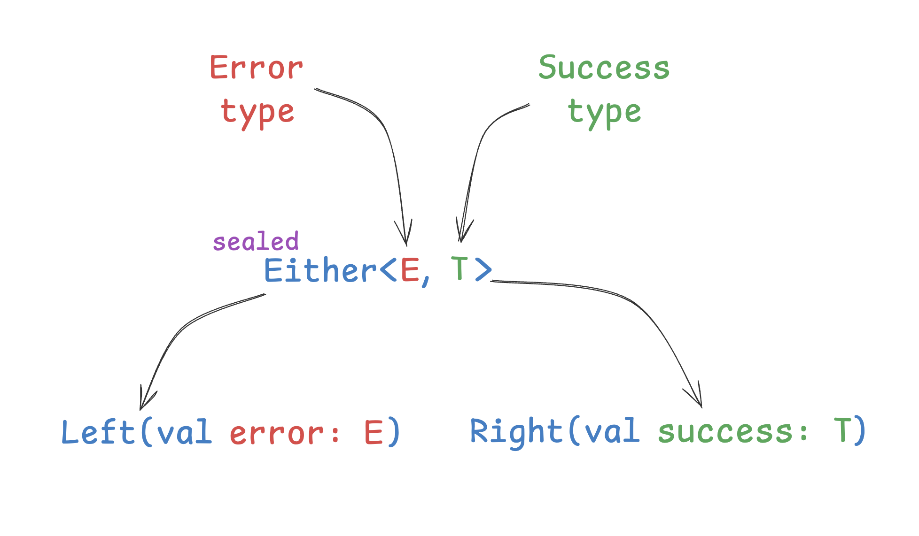
Union Types? Not quite...
Rust, Scala, Haskell, a lot more – Either Monad

Slide 45
Union Types? Not quite...
Swift - try-catch without exceptions
func canThrowErrors() throws(SomeError) -> String
func canHandleErrors() {
do {
let user = try canThrowErrors()
} catch {
print("Exception occurred: \(error)")
}
}

Slide 46
Union Types? Not quite...
Swift - try-catch without exceptions
func map<T, E>(
_ transform: (Self.Element) throws(E) -> T,
) throws(E) -> [T] where E : Error

Slide 47
Union Types? Not quite...
Zig
const GetUserError = error{
UserNotFound,
TransportError,
};
const GetChatError = error{
ChatNotFound,
TransportError,
};
const MainError = GetUserError || GetChatError;
fn main() MainError ! Chat {
// ...
}

Slide 48
Union Types? Not quite...
Zig
const GetUserError = error{
UserNotFound,
TransportError,
};
const GetChatError = error{
ChatNotFound,
TransportError,
};
const MainError = GetUserError || GetChatError;
fn main() MainError ! Chat {
// ...
}
typealias GetUserError =
| UserNotFound
| TransportError
typealias GetChatError =
| ChatNotFound
| TransportError
typealias MainError = GetUserError | GetChatError
fun main(): Chat | MainError {
// ...
}

Slide 49

Union Types? Never.

Slide 50
Untagged
Union Types? Never.

Slide 51
Untagged
Union Types? Never.
String | Int

Slide 52
Better Developer Experience

Slide 53
Better Developer Experience
Better IDE Experience

Slide 54
Better Developer Experience
Better IDE Experience
fun getUser(userId: UserId): User | UserNotFound | TransportError
Main Actor
Error Attributes

Slide 55
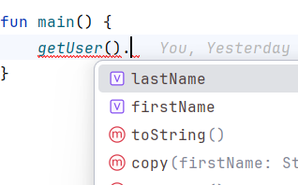
Better Developer Experience
Better IDE Experience
fun getUser(userId: UserId): User | UserNotFound | TransportError

Slide 56
Better Developer Experience
Better IDE Experience
fun getUser(userId: UserId): User | Bot

Slide 57
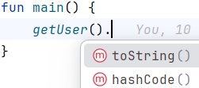
Better Developer Experience
Better IDE Experience
fun getUser(userId: UserId): User | Bot

Slide 58
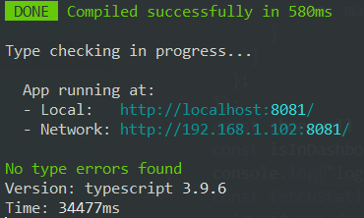
Better Developer Experience
Better IDE Experience
Better Compiler Performance

Slide 59
Better Developer Experience
Better IDE Experience
Better Compiler Performance

Slide 60

Better Developer Experience
Better IDE Experience
Better Compiler Performance

Slide 61

Better Developer Experience
Better IDE Experience
Better Compiler Performance

Slide 62
Better Developer Experience
Better IDE Experience
Better Compiler Performance
type Func = <T extends Options>(options: T) =>
T extends { returnAsObject: true }
? ObjectToReturn
: string;

Slide 63
Better Developer Experience
Better IDE Experience
Better Compiler Performance
type Func = <T extends Options>(options: T) =>
T extends { returnAsObject: true }
? ObjectToReturn
: string;
When types depend on other types that include conditionals and recursion, type-checking complexity grows exponentially.

Slide 64
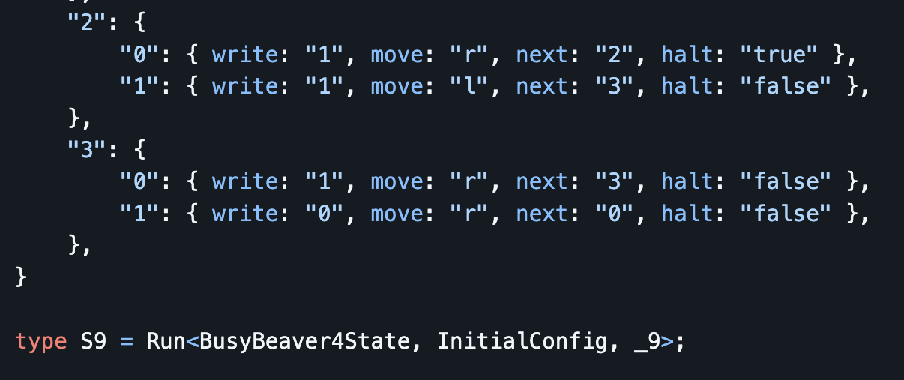
Better Developer Experience
Better IDE Experience
Better Compiler Performance

Slide 65

Better Developer Experience
Better IDE Experience
Better Compiler Performance

Slide 66
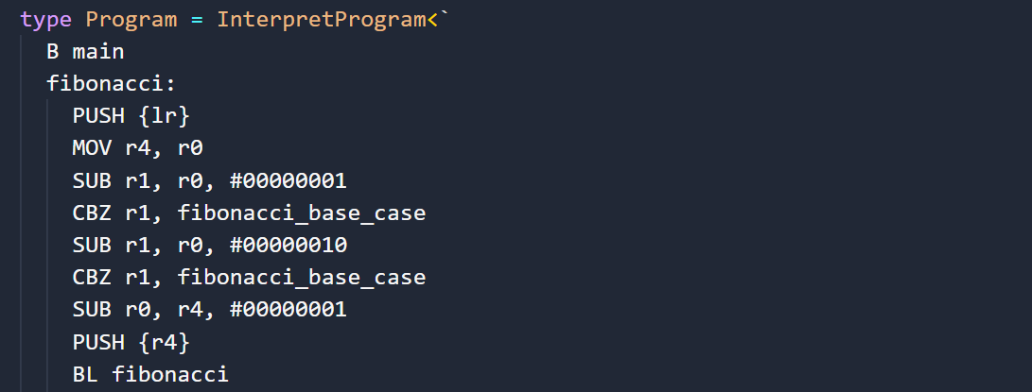
Better Developer Experience
Better IDE Experience
Better Compiler Performance

Slide 67
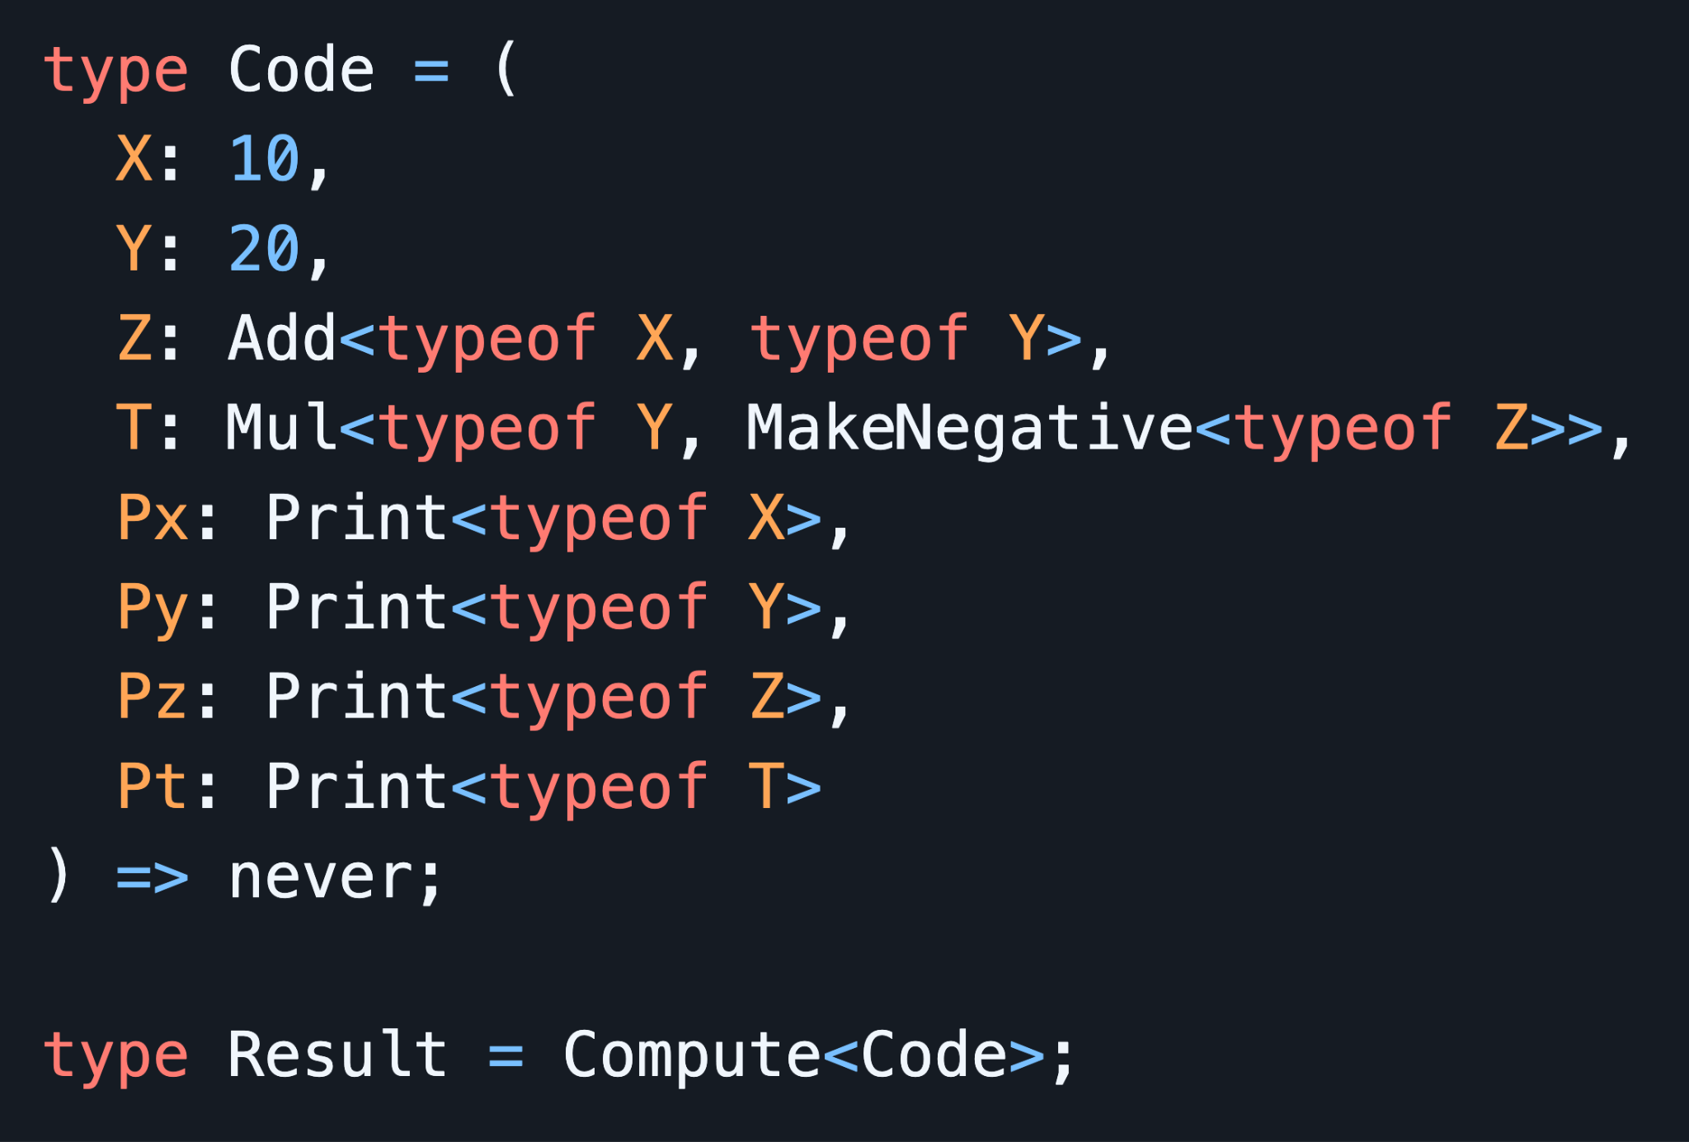
Better Developer Experience
Better IDE Experience
Better Compiler Performance

Slide 68
Better Developer Experience
Will it ever terminate?
Better IDE Experience
Better Compiler Performance

Slide 69
🔥 New top-level type just dropped

Slide 70
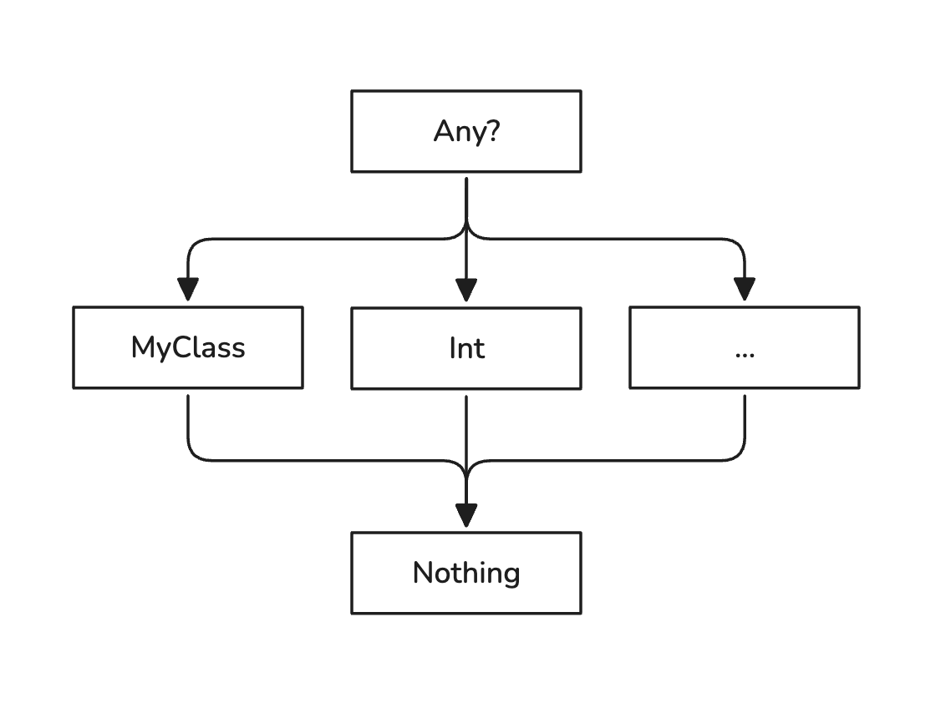
🔥 New top-level type just dropped

Slide 71
🔥 New top-level type just dropped

Slide 72
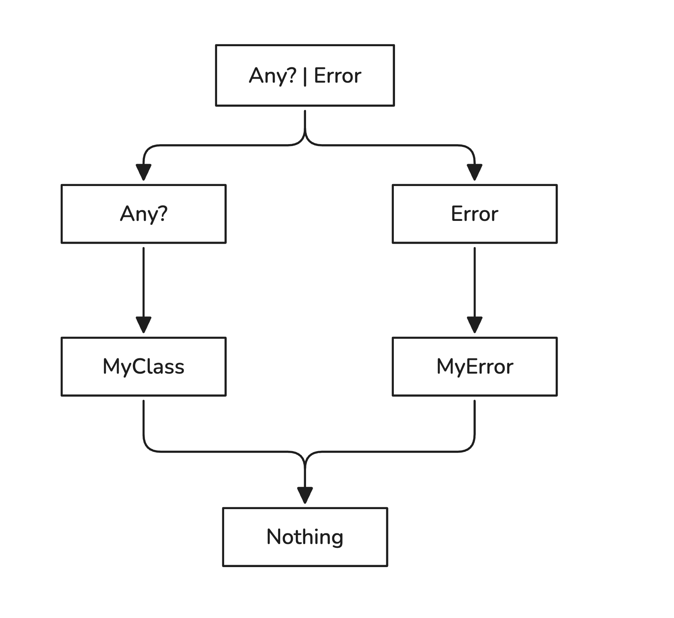
🔥 New top-level type just dropped

Slide 73
🔥 New top-level type just dropped
fun print(any: Any?) { ... }
fun main() {
print(MyError) // compile-time error
}

Slide 74
🔥 New top-level type just dropped
fun print(any: Any?) { ... }
fun main() {
print(MyError) // compile-time error
}
fun function(): T | Error
✅
fun function(): Error1 | Error2
fun function(): T1 | T2

Slide 75
🔥 New top-level type just dropped
fun print(any: Any?) { ... }
fun main() {
print(MyError) // compile-time error
}
fun function(): T | Error
✅
fun function(): Error1 | Error2
✅
fun function(): T1 | T2

Slide 76
🔥 New top-level type just dropped
fun print(any: Any?) { ... }
fun main() {
print(MyError) // compile-time error
}
fun function(): T | Error
✅
fun function(): Error1 | Error2
✅
fun function(): T1 | T2
❌

Slide 77
🔥 New top-level type just dropped
fun print(error: Error) { ... }
fun main() {
print(MyError) // OK!
}

Slide 78
🔥 New top-level type just dropped

Slide 79
Bonus Feature: null ambiguity

Slide 80
Bonus Feature: null ambiguity
val list = listOf(0, null, 2)
println(list.firstOrNull())

Slide 81
Bonus Feature: null ambiguity
val list = listOf(0, null, 2)
println(list.firstOrNull()) // no first element or first is null?

Slide 82
Bonus Feature: null ambiguity
error object NotFound
fun <T> List<T>.first(): T | NotFound

Slide 83
Bonus Feature: null ambiguity
fun <T> List<T>.first(): T | NotFound
fun main() {
val list = listOf(0, null, 2)
val first = list.first()
if (first is NotFound) {
println("Not found!")
} else {
println("First! $first")
}
}

Slide 84
Doesn’t this all seem familiar?

Slide 85
Doesn’t this all seem familiar?
fun <T> List<T>.first(): T | NotFound
fun main() {
val list = listOf(0, null, 2)
val first = list.first()
if (first is NotFound) {
println("Not found!")
} else {
println("First! $first")
}
}

Slide 86

Doesn’t this all seem familiar?
class NotFoundException : Exception()
fun <T> List<T>.first() throws NotFoundException: T
fun main() {
val list = listOf(0, null, 2)
try {
val first = list.first()
println("First! $first")
} catch (_: NotFoundException) {
println("Not found!")
}
}

Slide 87
Doesn’t this all seem familiar?
class NotFoundException : Exception()
fun <T> List<T>.first(): T
fun main() {
val list = listOf(0, null, 2)
val first = list.first()
println("First! $first")
}

Slide 88
Doesn’t this all seem familiar?
class NotFoundException : Exception()
fun <T> List<T>.first(): T
fun main() {
val list = listOf(0, null, 2)
val first = list.first()
println("First! $first")
}
throw is a hidden attribute,
it has no reflection in
the method signature

Slide 89

Turns out, JetBrains removed checked exceptions from Kotlin, just to introduce them once again!

Slide 90
Rich Errors are better
They have no stacktrace generation cost

Slide 91
Rich Errors are better
They have no stacktrace generation cost
They do have generics support

Slide 92
Rich Errors are better
They have no stacktrace generation cost
They do have generics support
fun getUser(userId: UserId): User | UserNotFound
fun <T, R, E : Error> List<T>.map(block: (T) -> R | E): List<R> | E
fun main() {
val list = listOf(0, 1, 2).map { userId ->
getUser(userId)
}
if (list is UserNotFound) {
println("Not all IDs are made the same")
} else {
println("Users: $list")
}
}

Slide 93
Finalizing: Exceptions vs Errors

Slide 94
Finalizing: Exceptions vs Errors
Guards and Invariants are exceptions

Slide 95
Finalizing: Exceptions vs Errors
Guards and Invariants are exceptions
fun paging(offset: Int, length: Int): Paging {
require(offset >= 0) { "Offset can't be negative" }
require(length > 0) { "Length must be positive" }
return Paging(offset, length)
}

Slide 96
Finalizing: Exceptions vs Errors
Guards and Invariants are exceptions
Anything else is errors (recoverable errors)

Slide 97
Finalizing: Exceptions vs Errors
Guards and Invariants are exceptions
Anything else is errors (recoverable errors)
error object NicknameTooShort
error object NicknameTooLong
fun User(nickname: String): User | NicknameTooShort | NicknameTooLong {
if (nickname.length < 5) return NicknameTooShort
if (nickname.length > 50) return NicknameTooLong
return User(nickname)
}

Slide 98
Checked Exceptions Done Right

Slide 99
Checked Exceptions Done Right
Someone @ JetBrains

Slide 100
Checked Exceptions Done Right
Someone @ JetBrains, probably

Slide 101
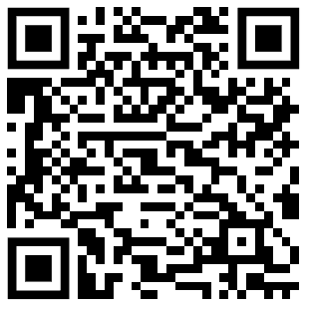
Checked Exceptions Done Right
Someone @ JetBrains, probably
Very Important Links ->

